Slide 1
Unique Corns
Parth, Allen, Clare,
Jenny, Pascal, Patrick

Slide 2
Paper Prototype

Slide 4
Heuristic Evaluation

Slide 5
10 Usability Heuristics
Visibility of system status
Match between system and the real world
User control and freedom
Consistency and standards
Error prevention
Recognition rather than recall
Flexibility and efficiency of use
Aesthetic and minimalist design
Help users recognize, diagnose, and recover from errors
Help and documentation

Slide 6
So What Do We Need?

Slide 7
Material #1
Why do we need this?

Slide 8
Material #2
Why do we need this?

Slide 9
Material #3
Why do we need this?

Slide 10
Material #4
Why do we need this?

Slide 11
In Class
Demonstration

Slide 12
What Did We Expect?
Expectation #1
Expectation #2
Expectation #3
Expectation #4

Slide 13
What happened?
What were the results?

Slide 14
Moving Forward…
Material #1
Material #2
Material #3
Material #4
Material #5
Material #6

Slide 15
I predict that...

Slide 16
I can picture...

Slide 17
A question I have is...

Slide 18
This is like...

Slide 19
This reminds me of...

Slide 20
I’m confused about...

Slide 21
I’ll reread this…(fix-up)

Slide 22
The big idea here is...

Slide 23
I think/believe/wonder...

Slide 24
Refined Solution

Slide 25
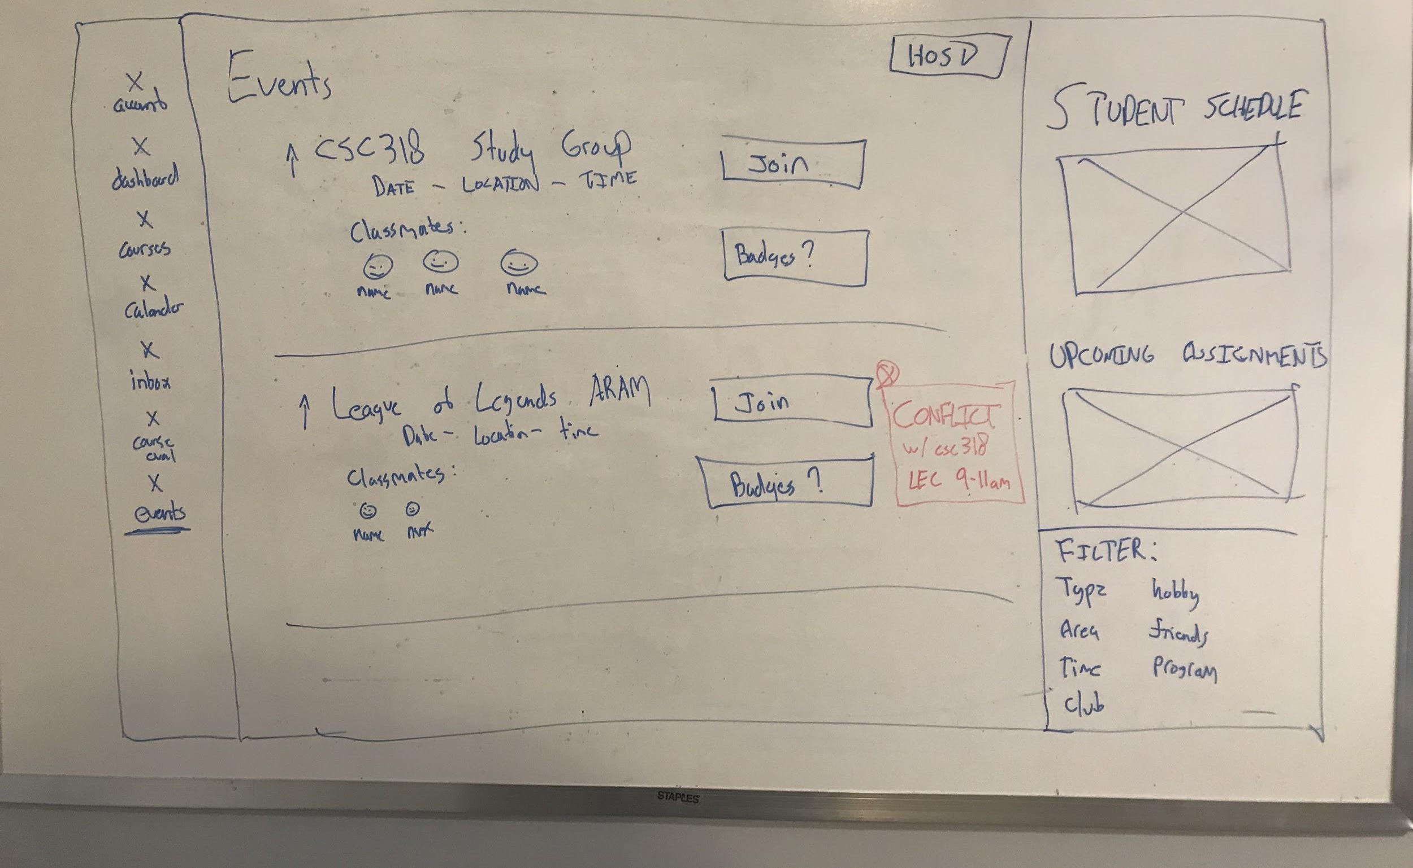
Bringing all ideas together
Web/Mobile app
Takeaways
Connecting a student’s time schedule and bringing all events across all different platforms into one location
Reward System
Badge System (Prof Ashton Anderson from cs dept.)
Schedule, exam conflict easily identified
Colour-coded, built-in calendar
A popularity measure (upvotes)
Based on classes/ classmates

Slide 26
Any Questions?

